Slide 1

Ad Scans – 01252026
ACER CONFIDENTIAL

Slide 2
Best Buy

Slide 3


Best Buy
01/23/2025~01/29/2026

Slide 4
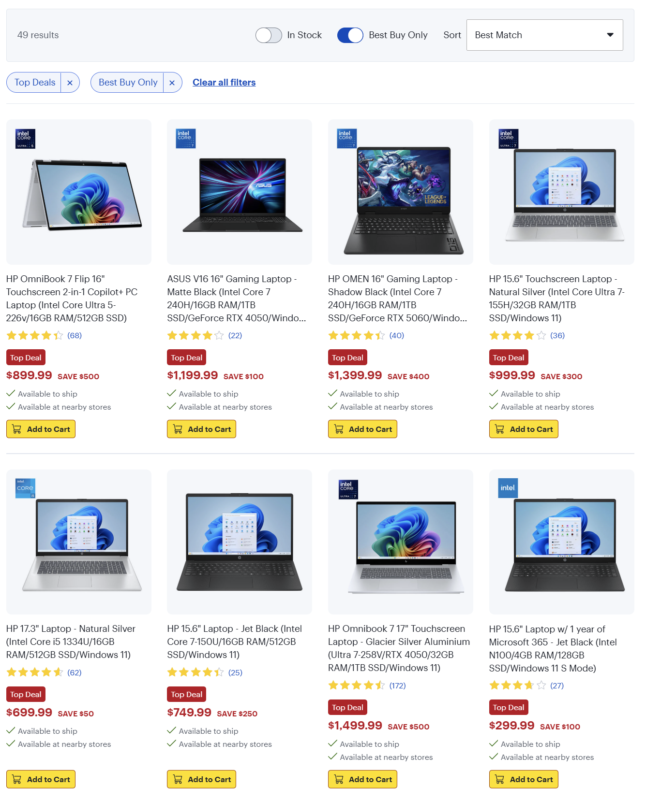
Best Buy
01/23/2025~01/29/2026

Slide 5
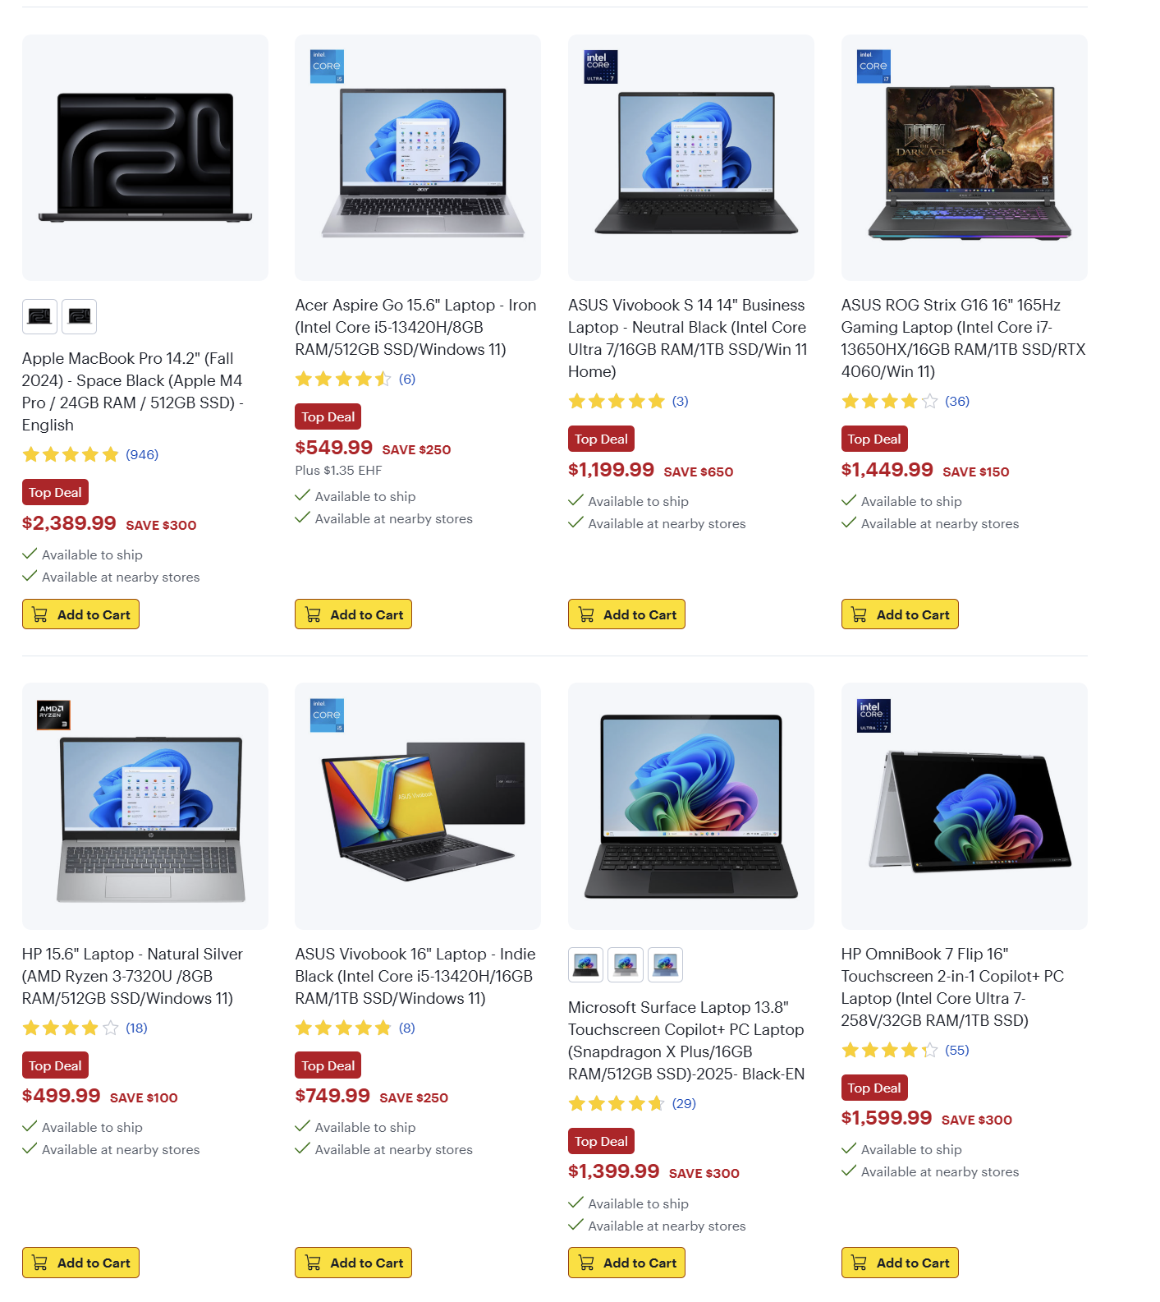
Best Buy
01/23/2025~01/29/2026

Slide 6
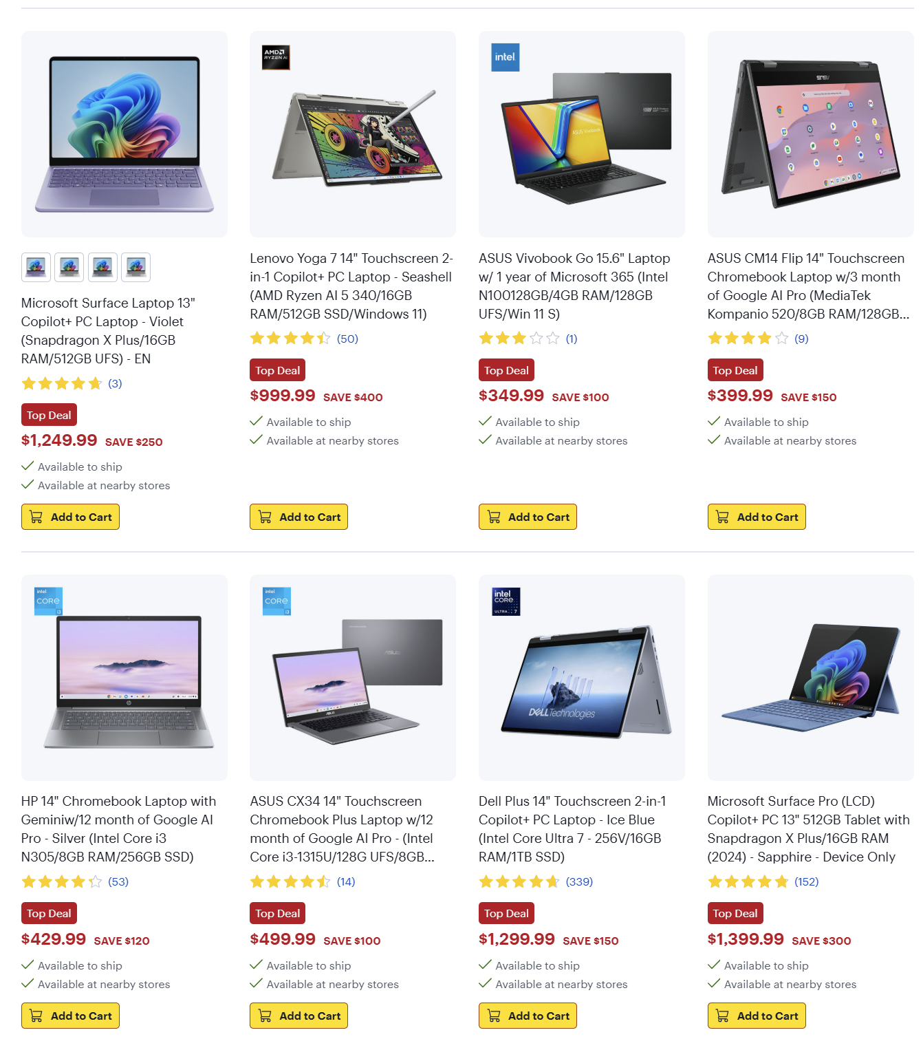
Best Buy
01/23/2025~01/29/2026

Slide 7
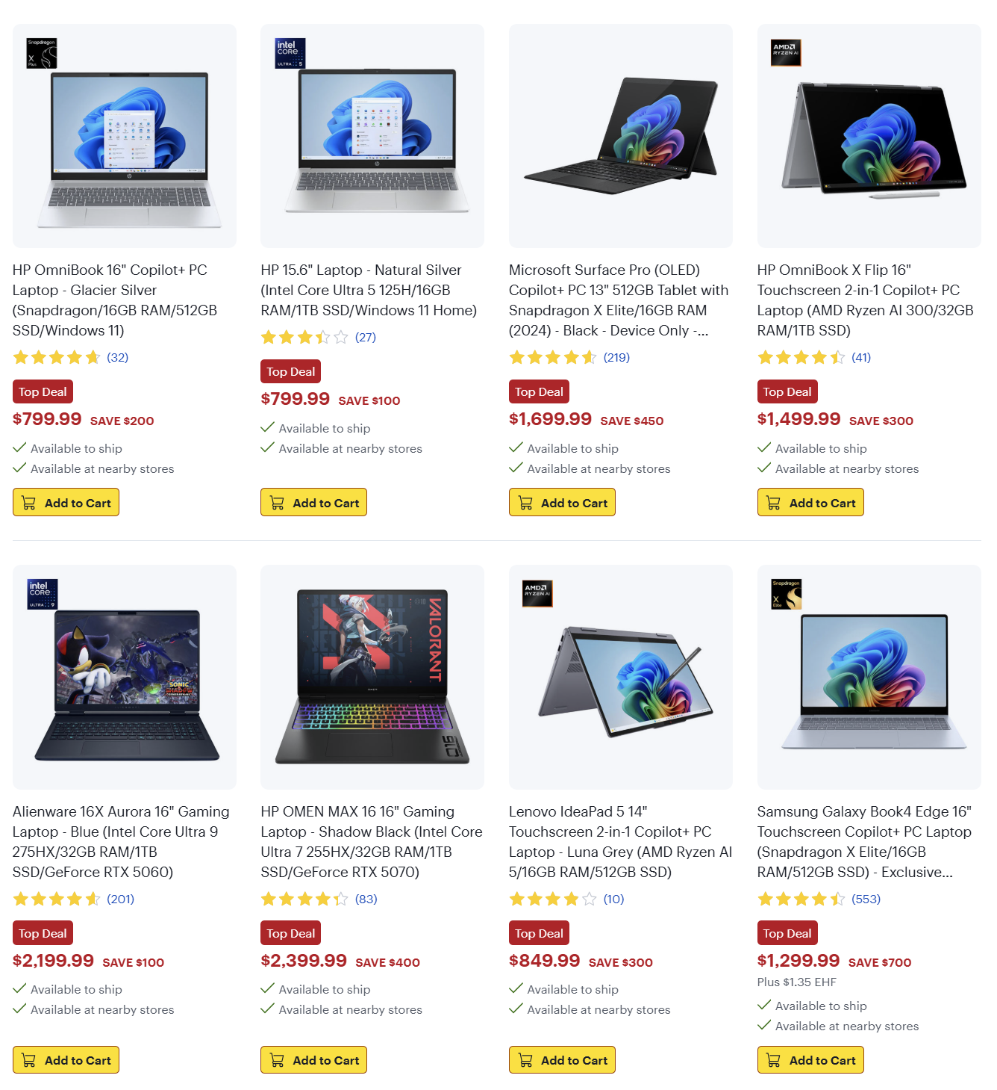
Best Buy
01/23/2025~01/29/2026

Slide 8
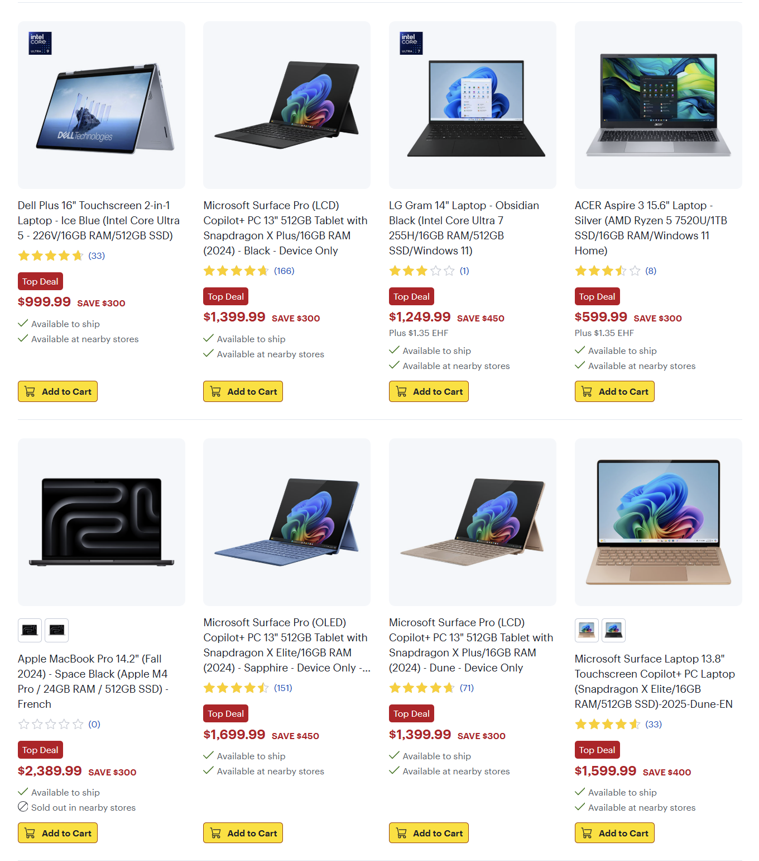
Best Buy
01/23/2025~01/29/2026

Slide 9
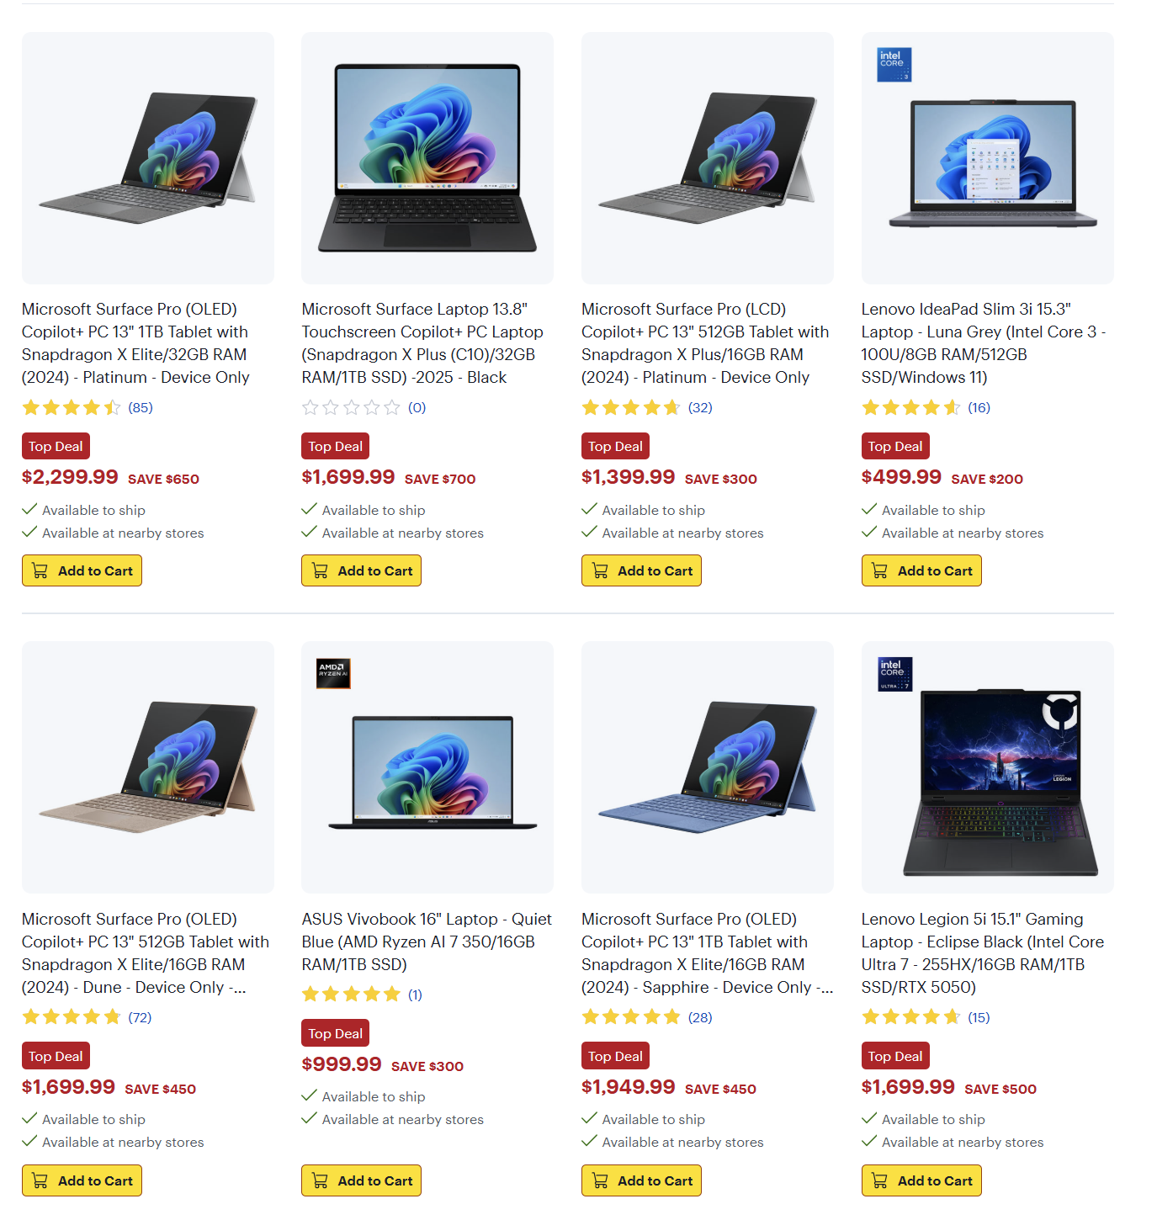
Best Buy
01/23/2025~01/29/2026

Slide 10
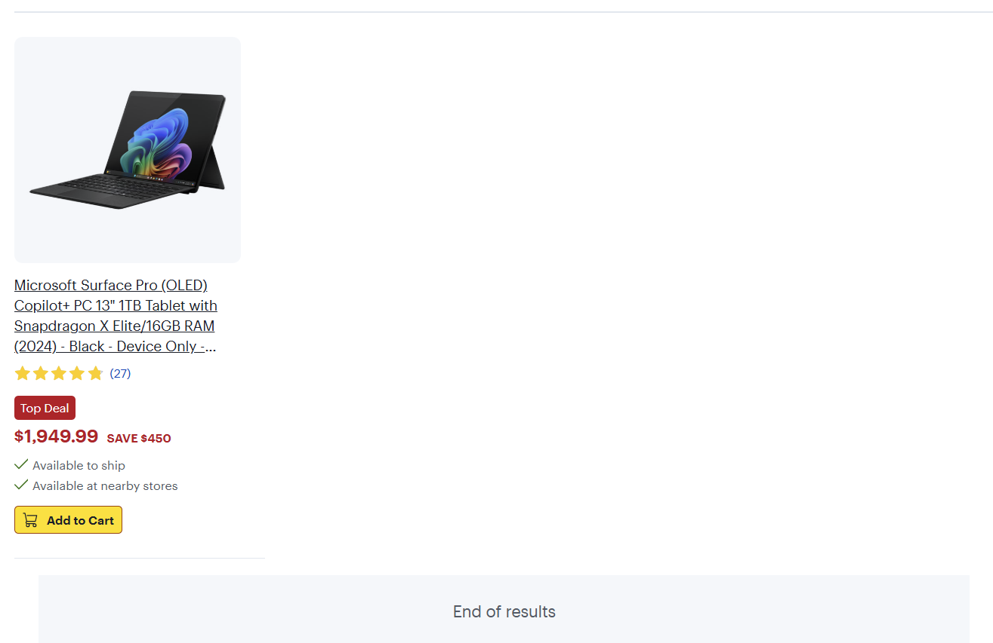
Best Buy
01/23/2025~01/29/2026

Slide 11
Staples

Slide 12
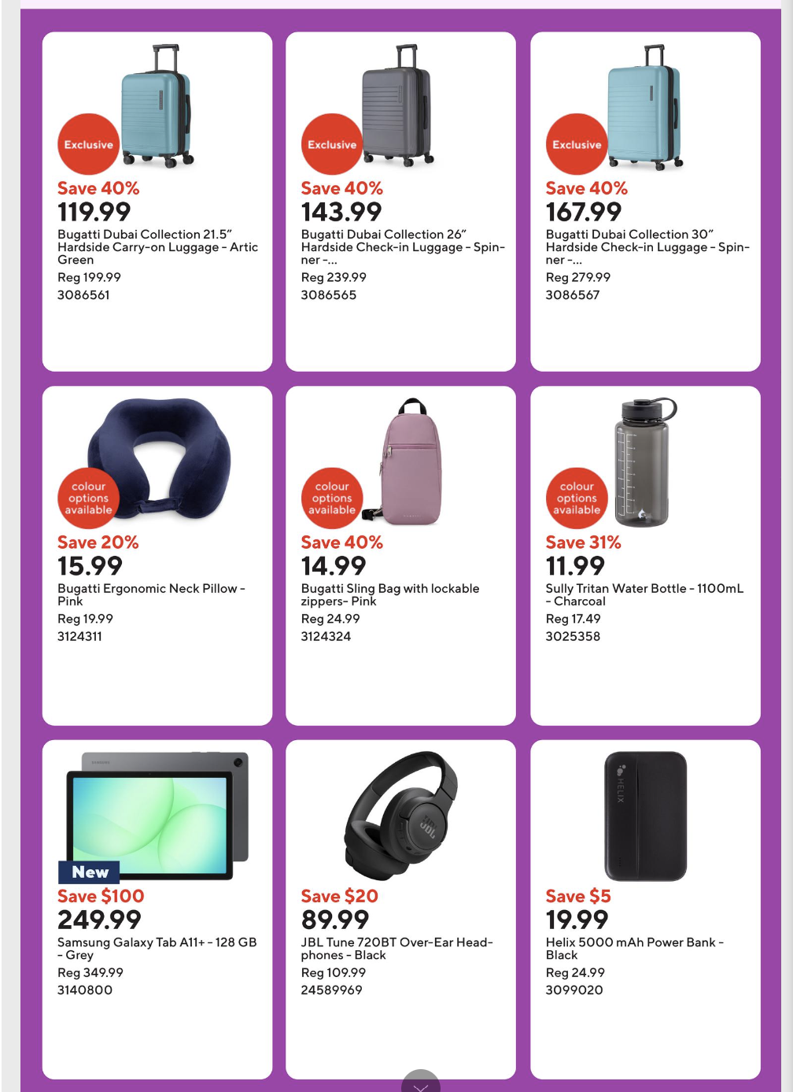
Staples
01/23/2026 - 01/29/2026
Notes:
https://www.staples.ca/a/content/flyers

Slide 13
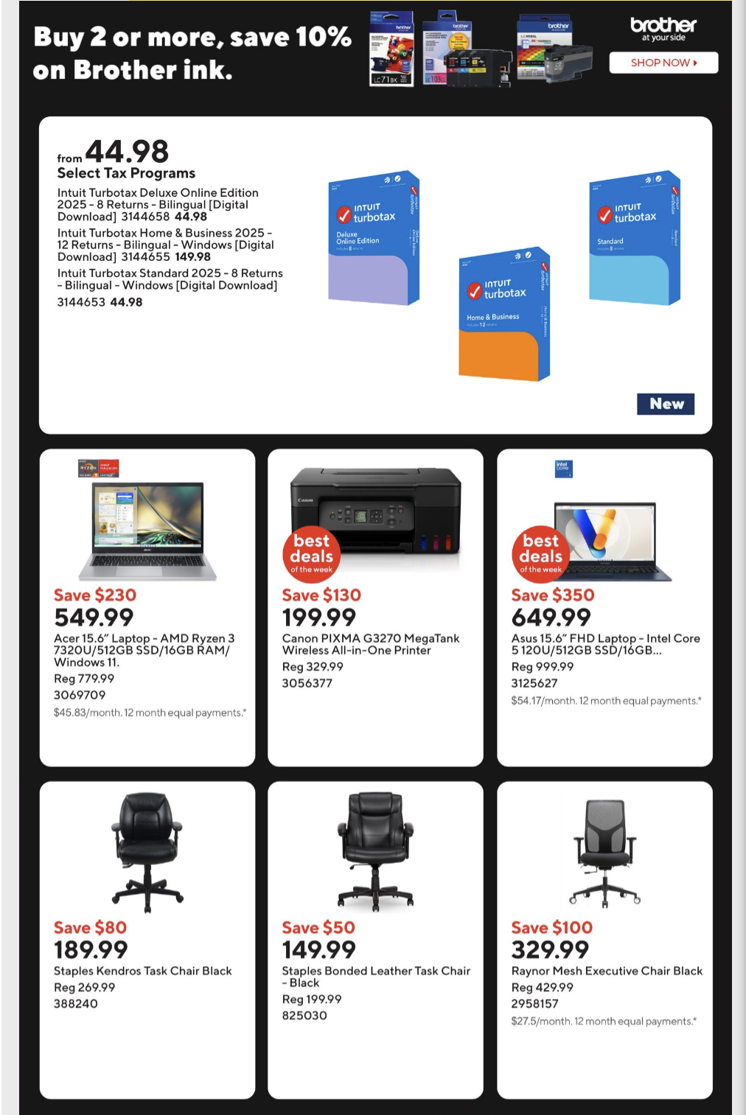
Staples
01/23/2026 - 01/29/2026
Notes:
https://www.staples.ca/a/content/flyers

Slide 14
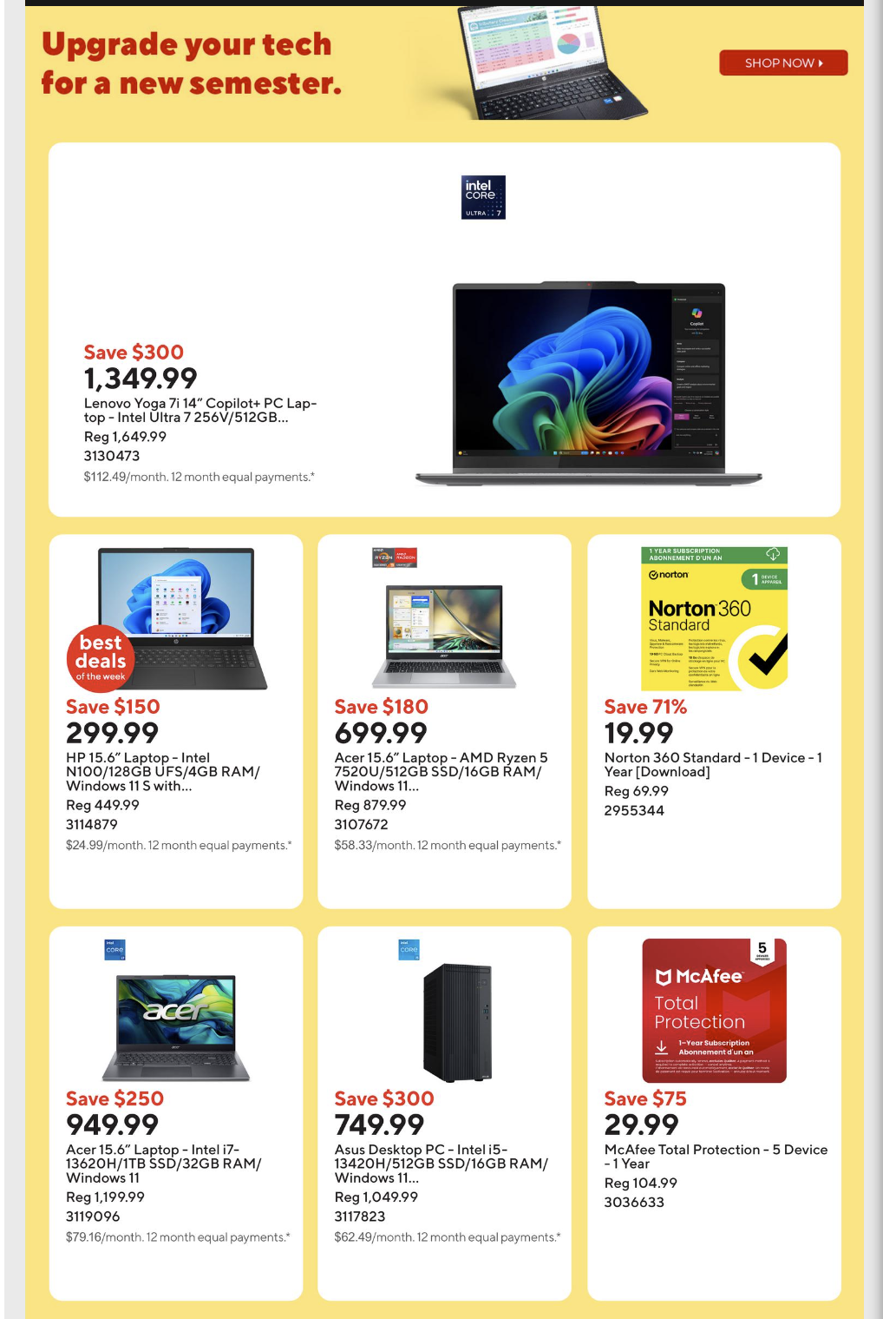
Staples
01/23/2026 - 01/29/2026
Notes:
https://www.staples.ca/a/content/flyers

Slide 15

Staples
01/23/2026 - 01/29/2026
Notes:
https://www.staples.ca/a/content/flyers

Slide 16

Staples
01/23/2026 - 01/29/2026
Notes:
https://www.staples.ca/a/content/flyers

Slide 17

Staples
01/23/2026 - 01/29/2026
Notes:
https://www.staples.ca/a/content/flyers

Slide 18
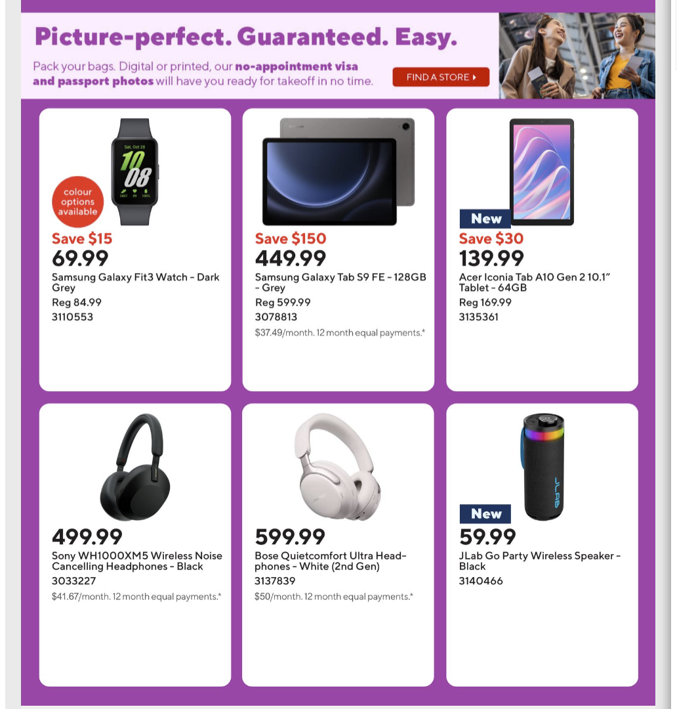
Staples
01/23/2026 - 01/29/2026
Notes:
https://www.staples.ca/a/content/flyers

Slide 19
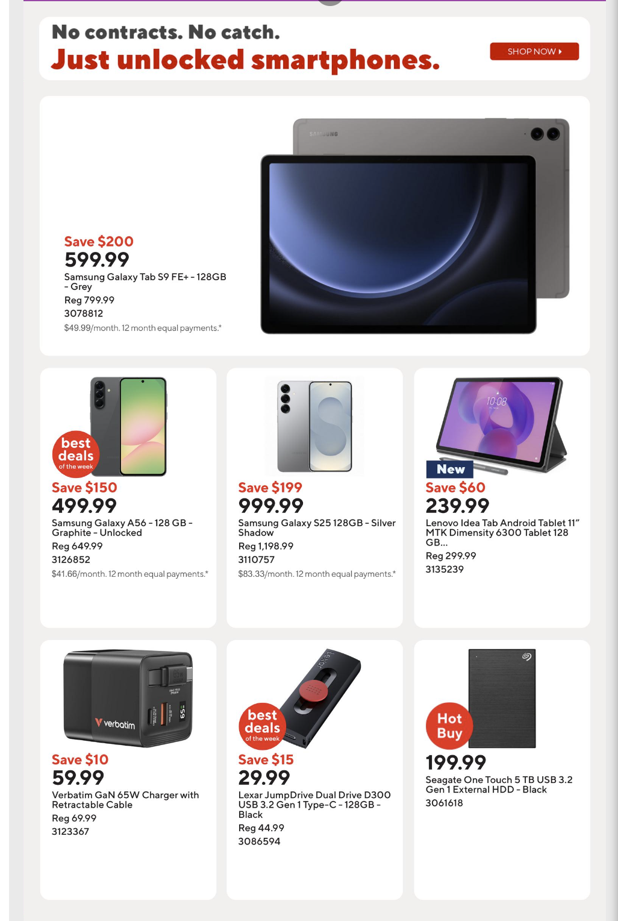
Staples
01/23/2026 - 01/29/2026
Notes:
https://www.staples.ca/a/content/flyers

Slide 20
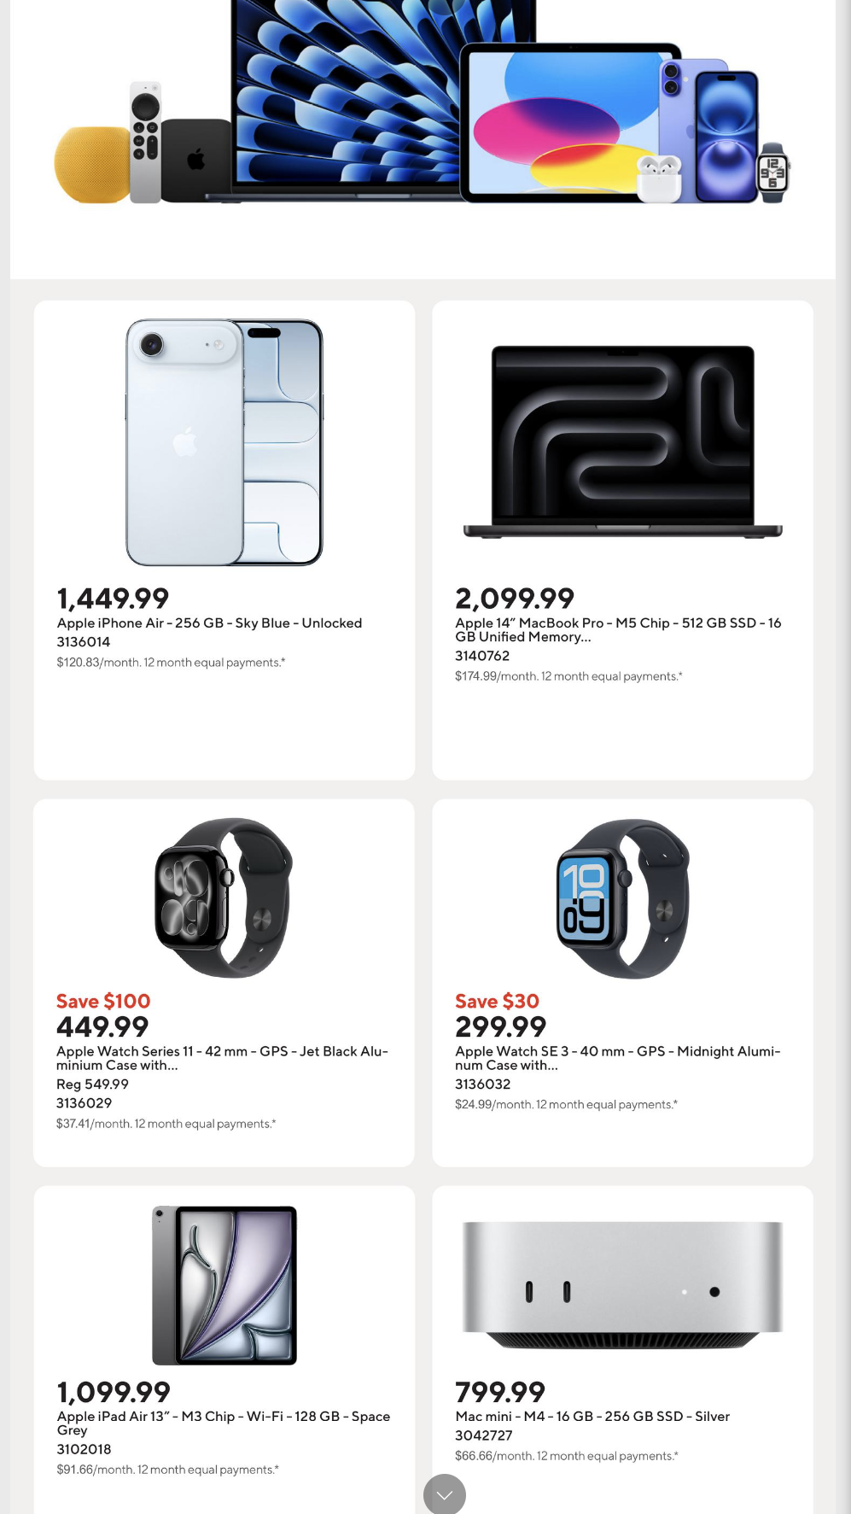
Staples
01/23/2026 - 01/29/2026
Notes:
https://www.staples.ca/a/content/flyers

Slide 21
Walmart

Slide 22
Walmart
01/22/2026-01/28/2026
No CE

Slide 23
Costco

Slide 24
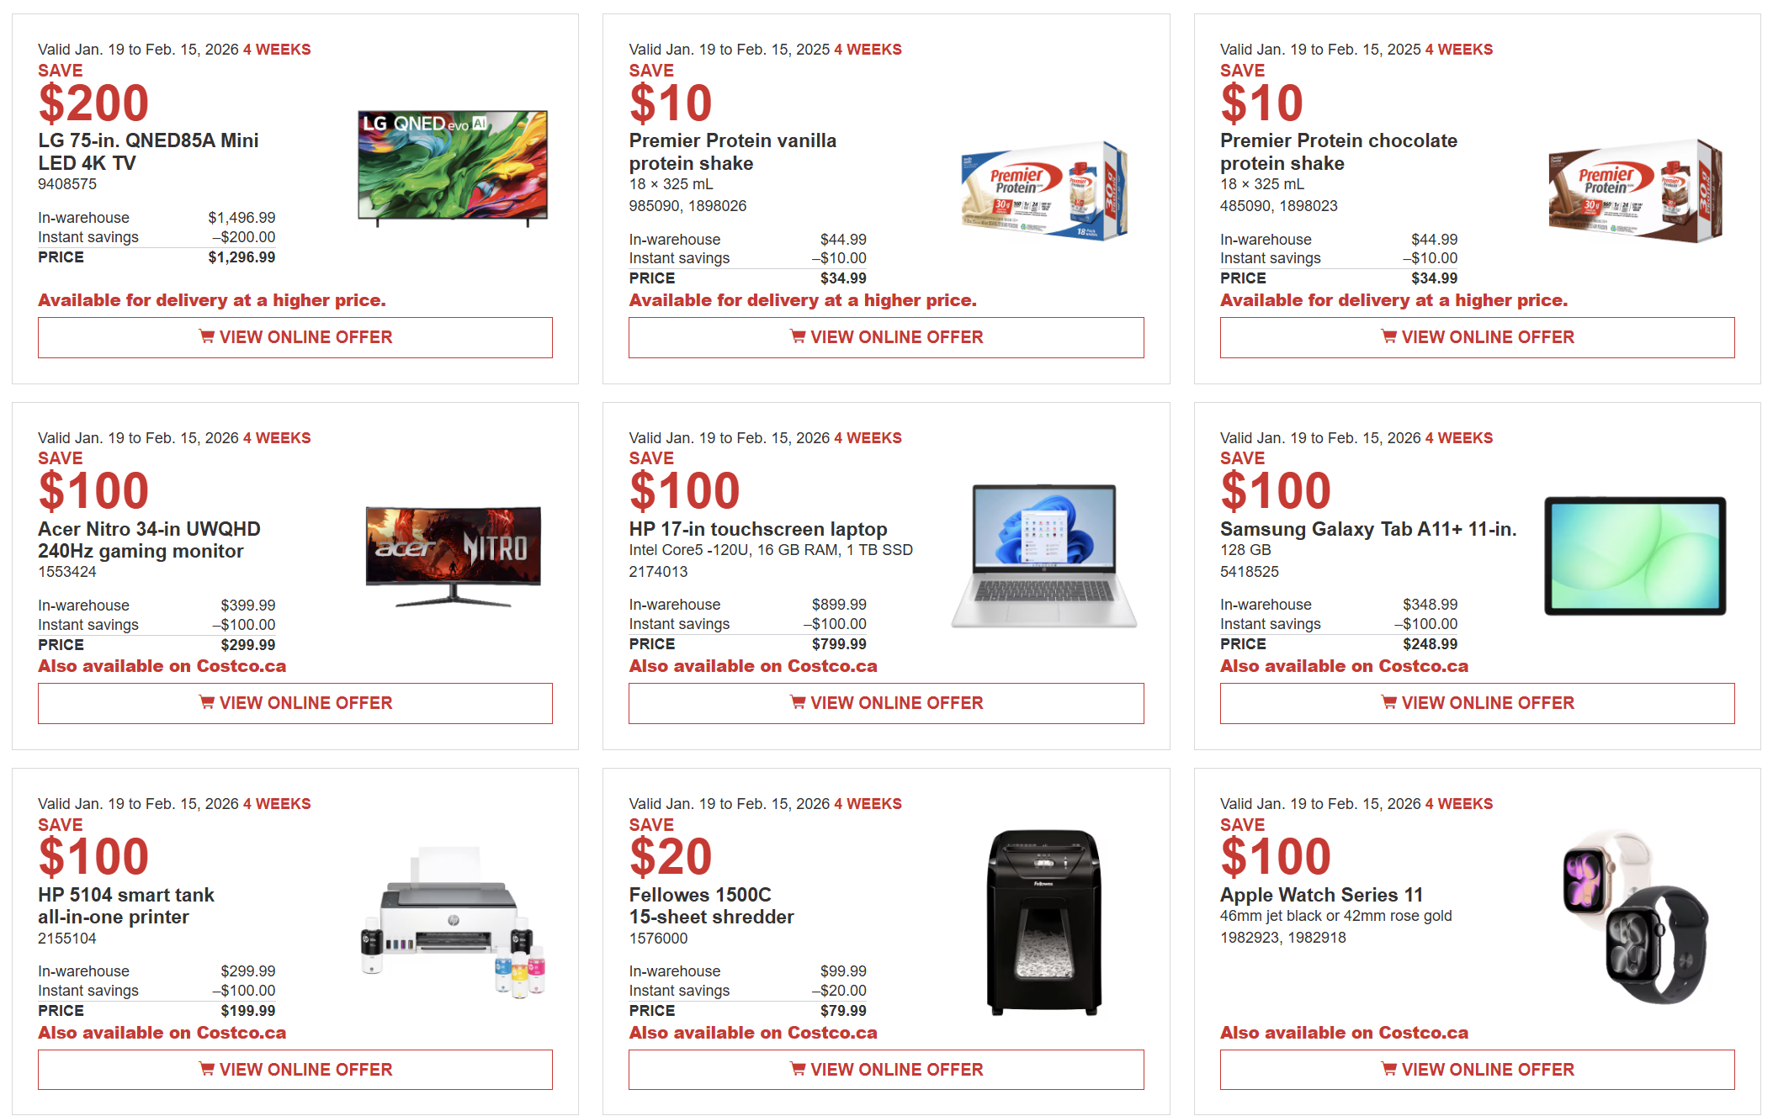
Costco
1/19/2025-02/01/2026

Slide 25
Others

Slide 26
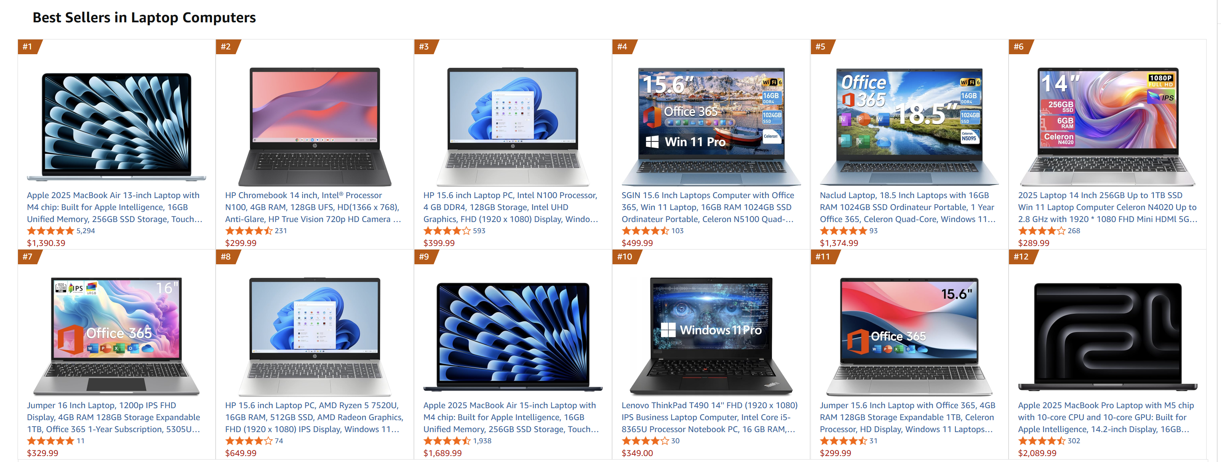
Others
Notes:
https://www.amazon.ca/gp/bestsellers/electronics/677252011?ref_=Oct_d_obs_S&pd_rd_w=RWft0&content-id=amzn1.sym.a26ace70-029b-45dd-99a6-bbbb61b20bbb&pf_rd_p=a26ace70-029b-45dd-99a6-bbbb61b20bbb&pf_rd_r=J0K45KSX766KDM28AB5H&pd_rd_wg=VKS9u&pd_rd_r=5853fcbd-0ebf-4327-bd55-0be82cebc1f2

Slide 27
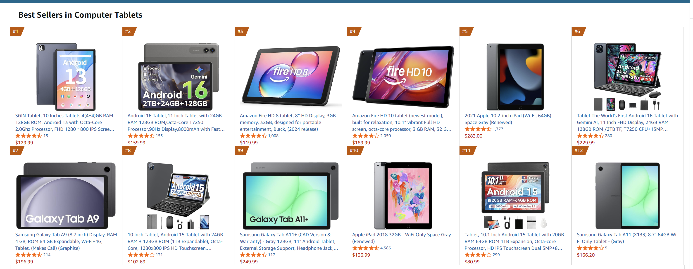
Others
Notes:
https://www.amazon.ca/gp/bestsellers/electronics/2690953011?ref_=Oct_d_obs_S&pd_rd_w=3Z9A2&content-id=amzn1.sym.fa7a9e1f-86e8-45b2-8cea-c300cf9f9e1e&pf_rd_p=fa7a9e1f-86e8-45b2-8cea-c300cf9f9e1e&pf_rd_r=M23A5YZ44C9FRHTQK1DK&pd_rd_wg=DFpRJ&pd_rd_r=dbbdf730-e6b3-43bb-90ee-4586dda31b67

Slide 28
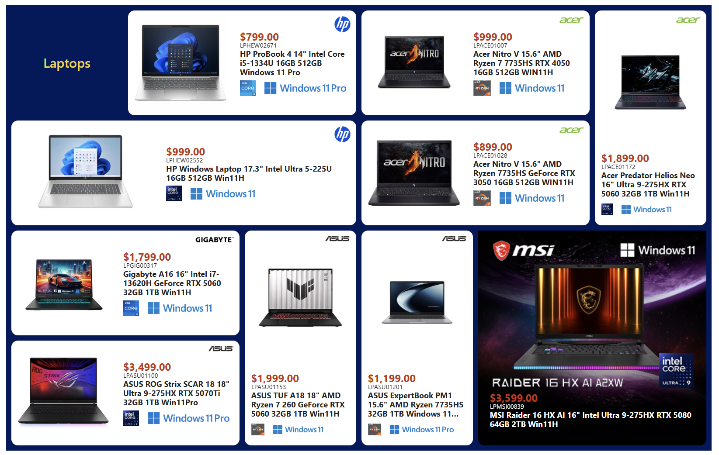
Others
01/23/2026-01/29/2026

Slide 29
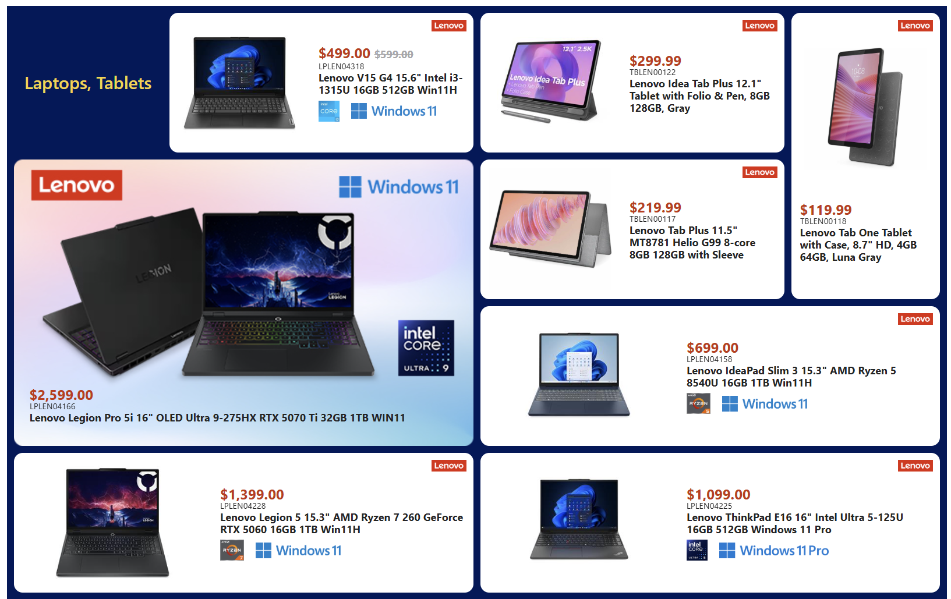
Others
01/23/2026-01/29/2026

Slide 30
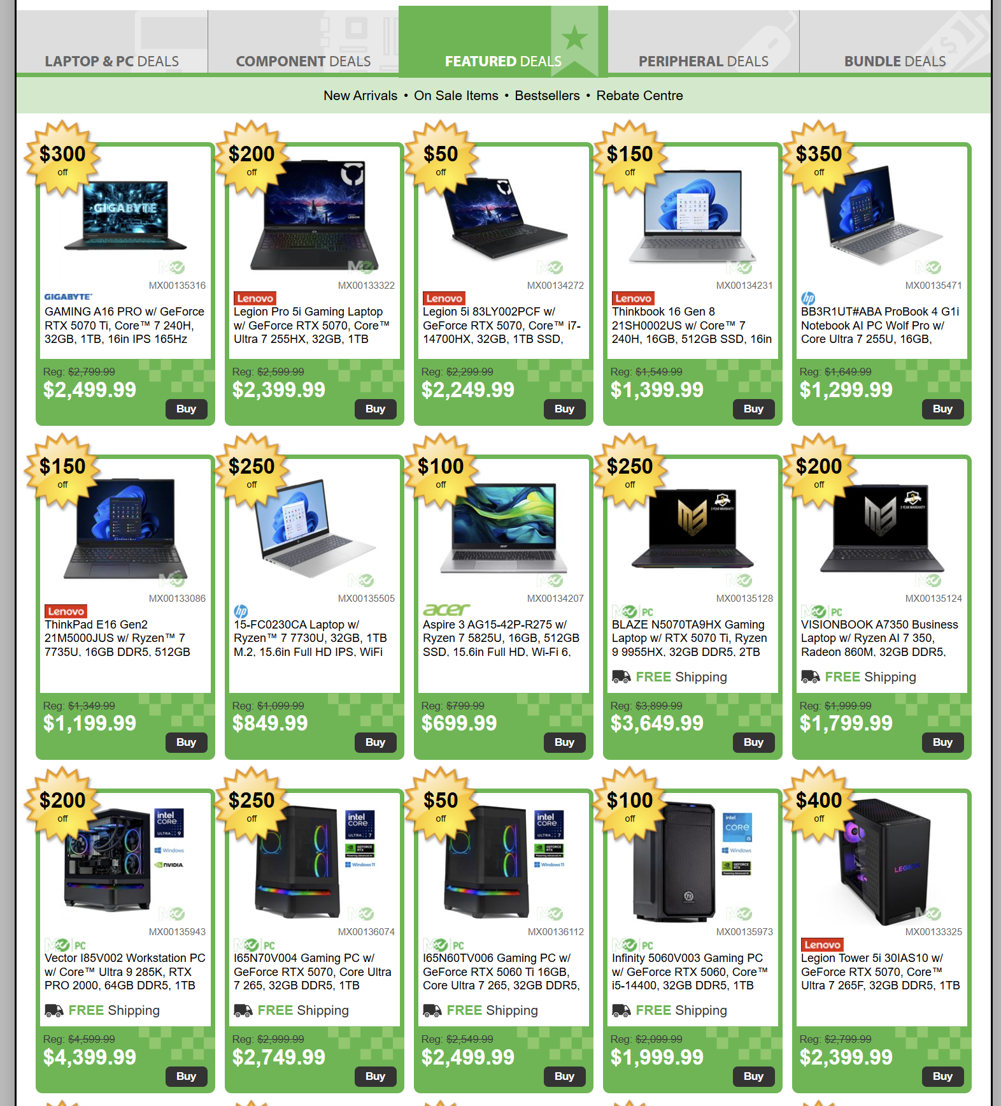
Others
01/23/2026-01/29/2026

